Slide 1
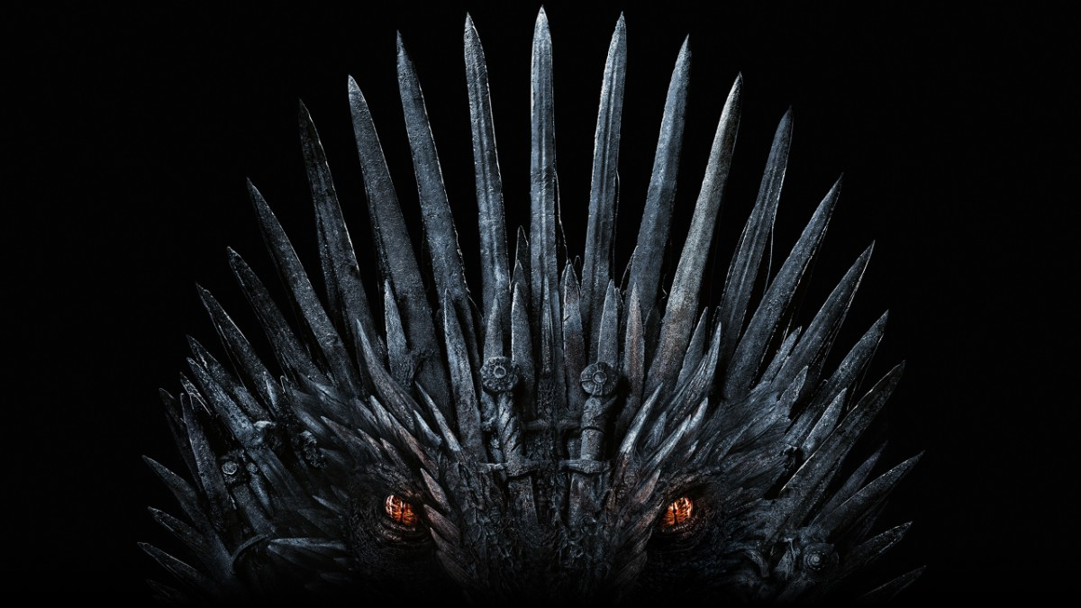
Game of Thrones Season 8 Sentiment Analysis Natasha Borders Drake Ballew
Notes:
Natasha
Good morning, I am Natasha and I’m Drake and we’re going to be talking about our Sentiment Analysis of the Season 8 of Game of Thrones.

Slide 2
Spoilers are coming
Notes:
Natasha
Needless to say, there will be spoilers for all the episodes of this season so beware.

Slide 3
“One of the two fatal decisions that may define “Game of Thrones” in the long term is Benioff and Weiss’s decision to make two truncated final seasons of the show, a choice that may go down as one of the worst in recent television history.”
https://www.washingtonpost.com/opinions/2019/05/20/game-thrones-season-episode-review-iron-throne-melts/
Notes:
Natasha. The emotions have been running high concerning this season.
Multiple misses have been sighted for each episode, and quotes such as this one have been shared on social media everywhere.
This reaction came from Washington post and says: one of the two fatal decisions that may define Game of Thrones in the long term is the writers’ decision to make two truncated final seasons of the show, a choice that may go down as one of the worst in recent television history.
This is a harsh judgement and we’re going to examine the sentiment of the fans as they watch the final season to see if this is indeed the case.
Many other articles and opinions we have seen center around the fact that the writing has diverged from GRRM’s original works even further now that the show has surpassed the books and has gotten rushed and sloppy overtime. Drake and I entered the analysis a week before the finale of the show fully anticipating to be wading through datasets full of anguish and tears by the end of it all. This is a report of our journey.

Slide 4
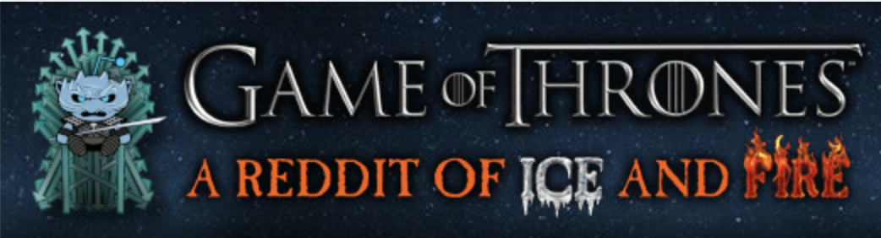
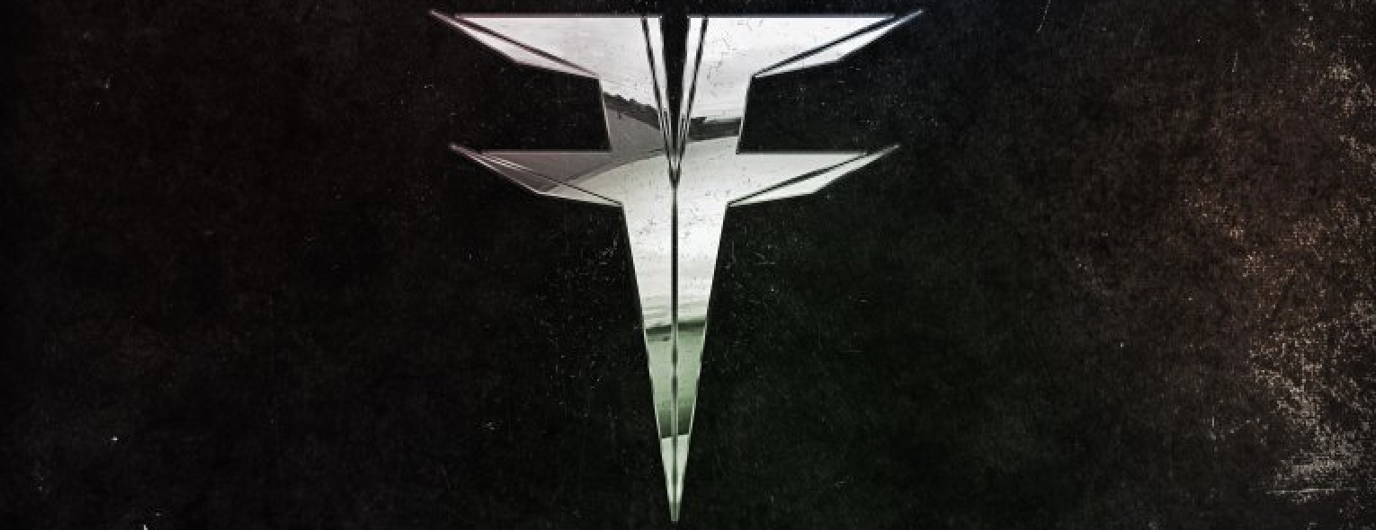
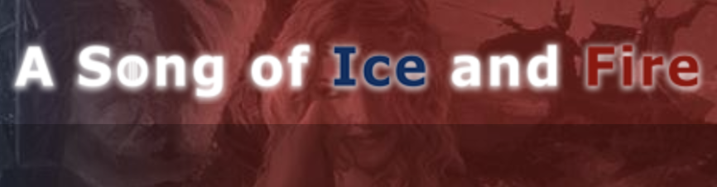
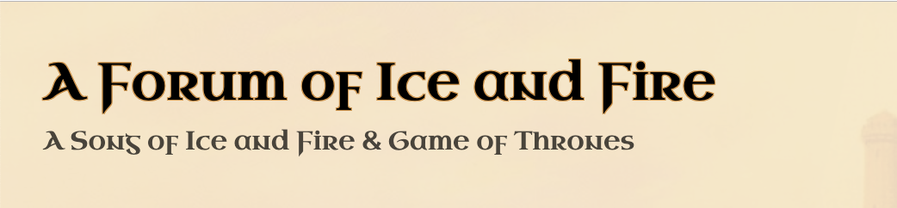
Data Sources
Members | Description
2.3M | This is a place to enjoy and discuss the HBO series, book series ASOIAF, and GRRM works in general. It is a safe place regardless of where you are in the story.
982K | We do not kneel. GoT/ASOIAF sub for non-kneelers. r/Freefolk neither encourages nor discourages piracy. We only take action to enforce reddit's sitewide rules. We believe people are mature enough to decide for themselves what content to view.
666K | News and discussions relating to George R. R. Martin's "A Song of Ice and Fire" novels, and all things ASOIAF with particular emphasis on the written series.
125K | The largest A Song of Ice and Fire & Game of Thrones forum on the web. Whether you are looking for discussions of the books or the show, there's a section for you a the forum.
Notes:
Drake
- Got our data from four forums, three from reddit’s Game of Thrones, Freefolk, and A Song of Ice and Fire subreddits, and one from the independent fan forum A Forum of Ice and Fire.
Each forum has a slightly different focus, with GoT appealing to all fans, Freefolk being more meme-driven, and A Song of Ice and Fire and A Forum of Ice and Fire attracting fans of the books and more diehard fans.

Slide 5
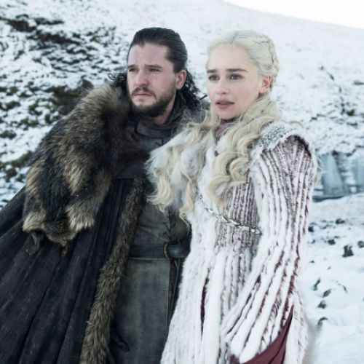
Sentiment Analysis
Notes:
Drake
- Having acquired our data, the first thing we did was look at how sentiment changed over time.

Slide 6
Sentiment Analysis
Purpose
To track the fans’ reactions to the 8th season of Game of Thrones over the course of the season.
Methods
Used natural language processing with Python and the VADER algorithm.
Aggregated over the period from April 1st, 2019 through May 20th, 2019.
Notes:
Drake
- We started looking at data starting April 1st – two weeks prior to the season premiere - through May 20th or the day after the final episode
- To help us tease out sentiment, we used VADER, which is particularly suited to social media data, recognizing things like all caps, punctuation, slang words, emoji , etc to capture sentiment.
- The goal was to capture sentiment over the course of the season and see how the different communities reacted to the show.
Purpose
To track the fans’ reactions to the 8th season of Game of Thrones over the course of the season.
Methods
Used natural language processing with Python and the VADER algorithm.
Aggregated over the period from April 1st, 2019 through May 20th, 2019.

Slide 7
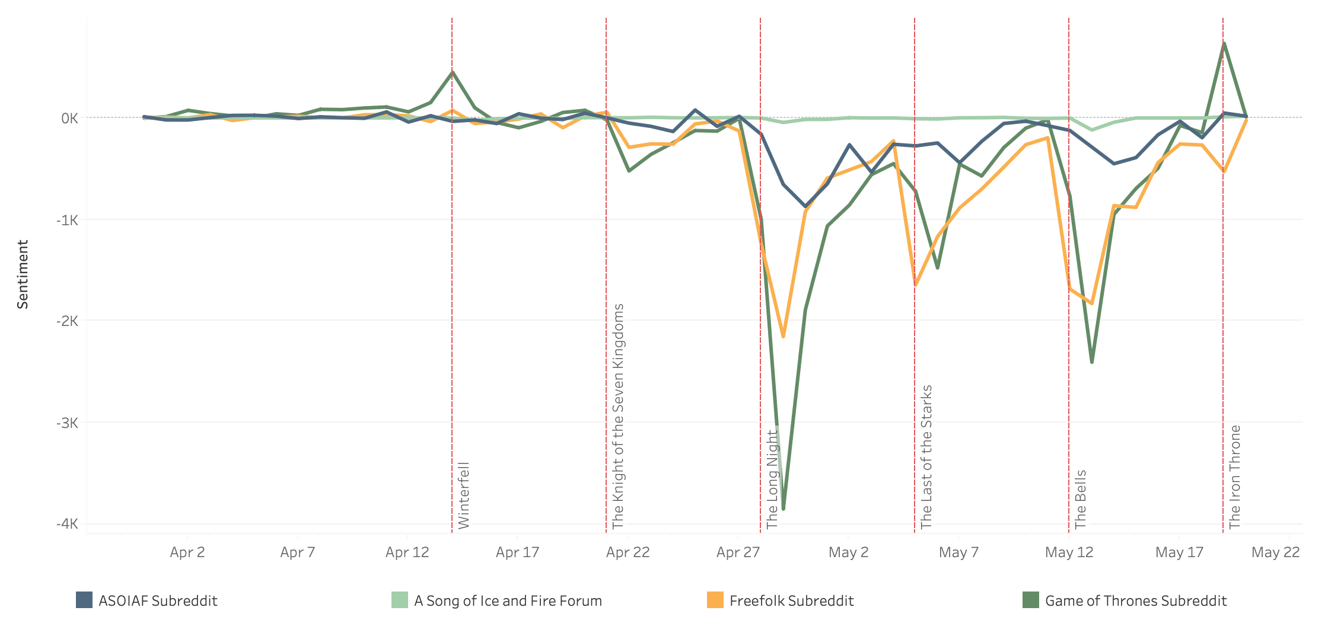
Aggregate Sentiment Analysis
Notes:
Drake
Our first pass at sentiment analysis look at aggregate sentiment by forum
It’s easy to see episodes in the season which generated strong opinions, like The Long Night (Night King), The Bells (King’s Landing), and The Iron Throne (finale).
One flaw with visualizing the data this way, however, is that it downplays the sentiments of lower-volume forums. For instance, the sentiment within the Forum of Ice & Fire looks essentially flat episode to episode within this view.
We wanted to explore whether this was actually true, so decided to look at mean sentiment as well.

Slide 8
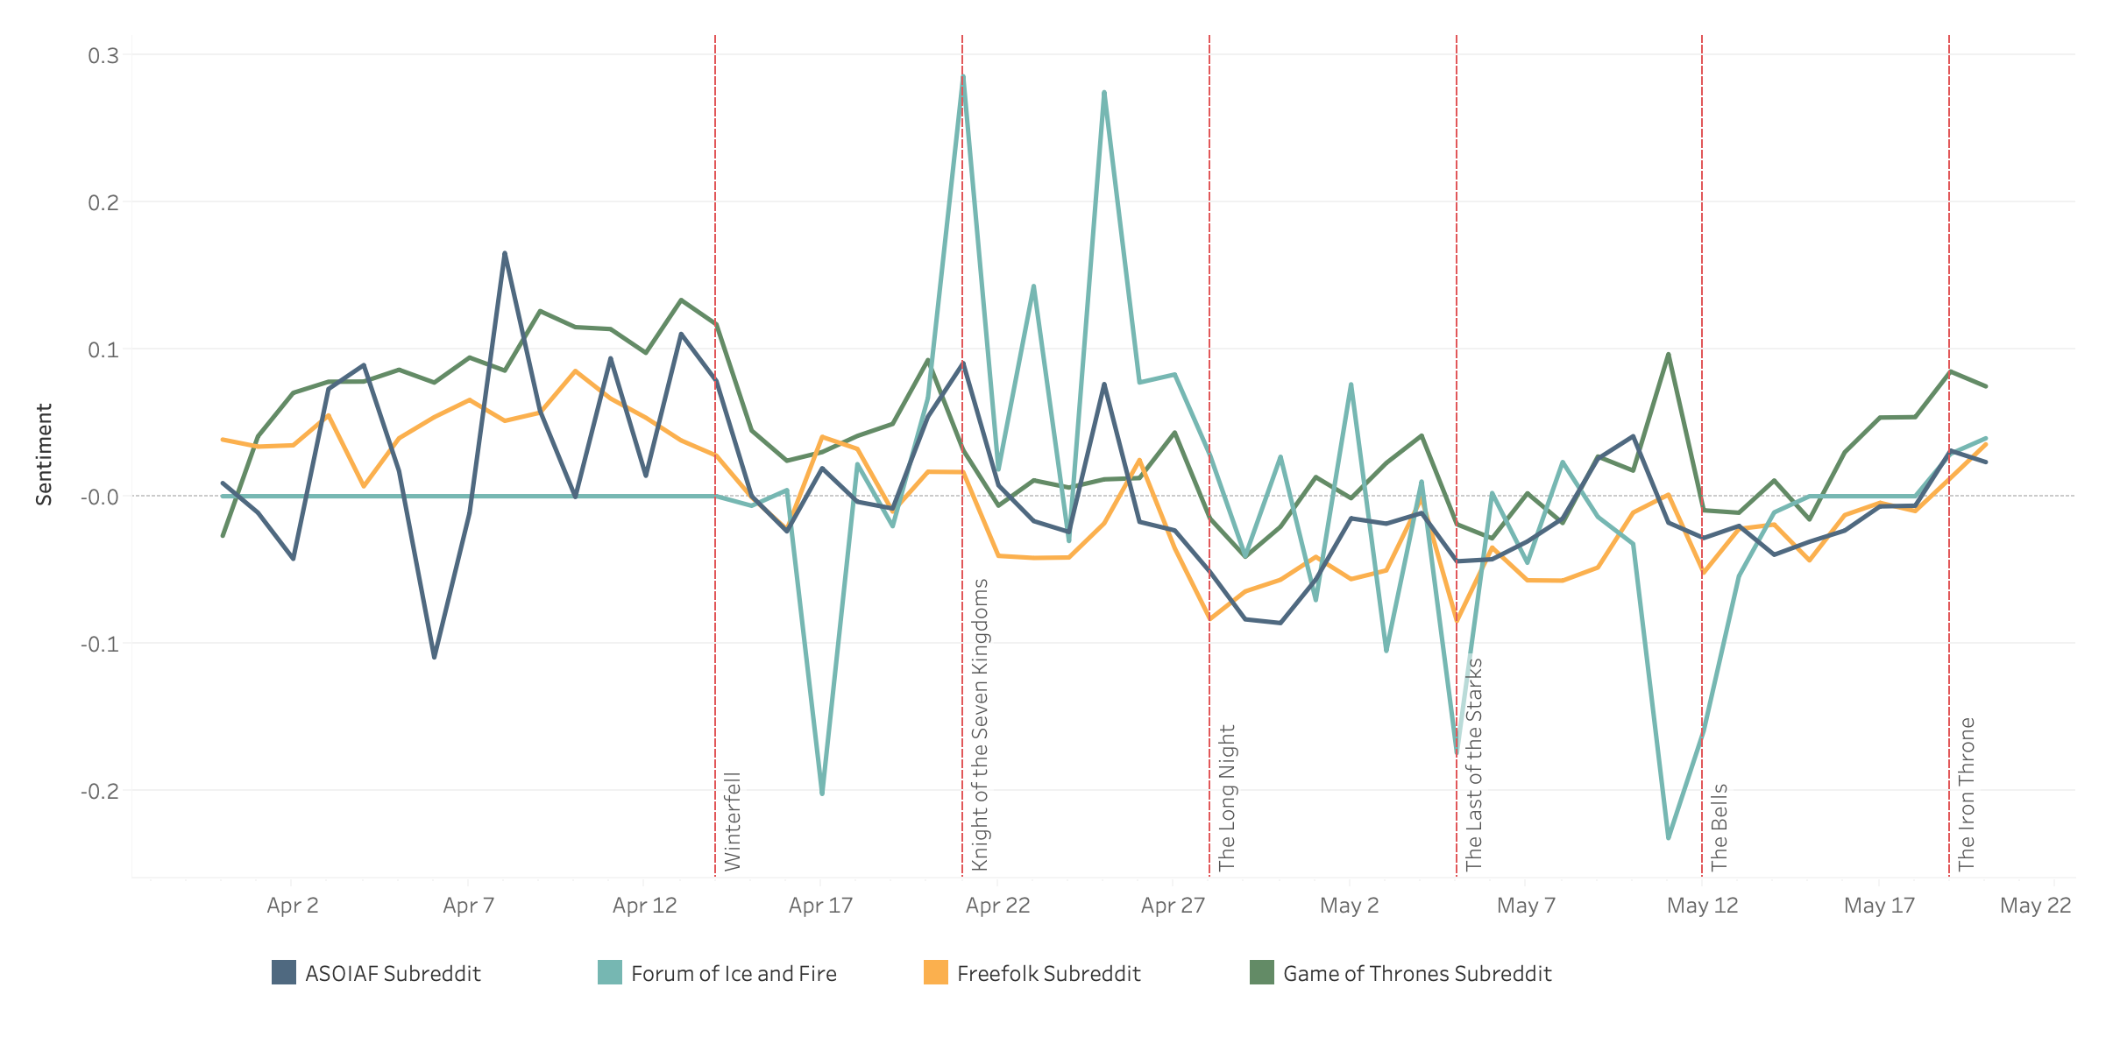
Mean Sentiment Analysis
Notes:
Natasha - Once we account for the difference in the number of people in the four channels and take the mean sentiments of each channel for each day, the resulting picture is more balanced and it’s easy to observe how volatile the fans on the forum are and how their reactions are more extreme than those on the three subreddits.
The general sentiment over the course of the season is less negative than we have expected to see.
Breaking down the reactions by channels, the Game of Thrones subreddit appear to be more positive overall compared to the forum and freefolk redditors’ reactions.
The feel-good Knight of the Seven Kingdoms episode elicits the highest level of positive reactions of the season, followed by the overall anticipation level before the premiere of Winterfell.

Slide 9
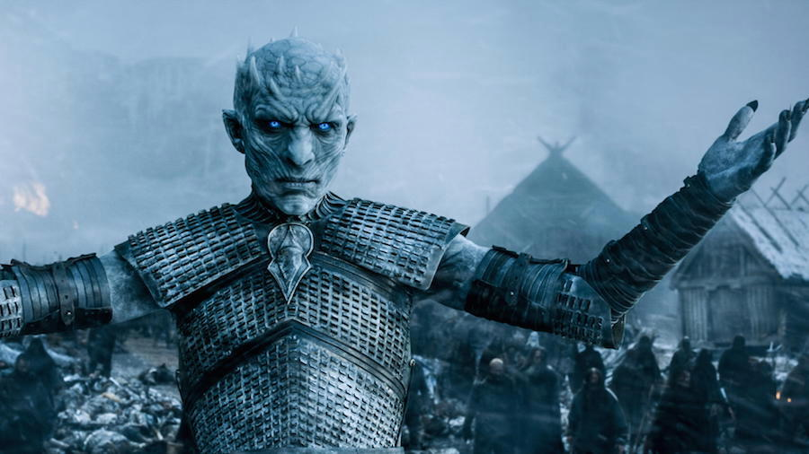
Topics and Fan Reactions by Episode
Notes:
Natasha
After looking at the sentiment overall, we examine what the fans were actually discussing.

Slide 10
Topic Modeling
Purpose
Tracking the fans’ discussions of the 8th season of Game of Thrones over the course of the season
Methods
LDA(latent Dirichlet allocation) analysis on the vectorized bag of words to determine the most salient topics of discussion among the fans starting the day of each episode and for the following week.
Notes:
Natasha - For this part of the analysis we used the LDA model and pyLDAviz tool to examine the topics discussed by fans present on all four platforms broken down by episode.
We’re going to take a look at the results in three slices, the period leading up to the Battle of Winterfell, the battle and the aftermath, and the siege of King’s Landing followed by the finale of the season.
In LDA, each document may be viewed as a mixture of various topics where each document is considered to have a set of topics that are assigned to it via LDA. This is identical to probabilistic latent semantic analysis (pLSA), except that in LDA the topic distribution is assumed to have a sparse Dirichlet prior. The sparse Dirichlet priors encode the intuition that documents cover only a small set of topics and that topics use only a small set of words frequently. In practice, this results in a better disambiguation of words and a more precise assignment of documents to topics. LDA is a generalization of the pLSA model, which is equivalent to LDA under a uniform Dirichlet prior distribution.^{[5]}

Slide 11
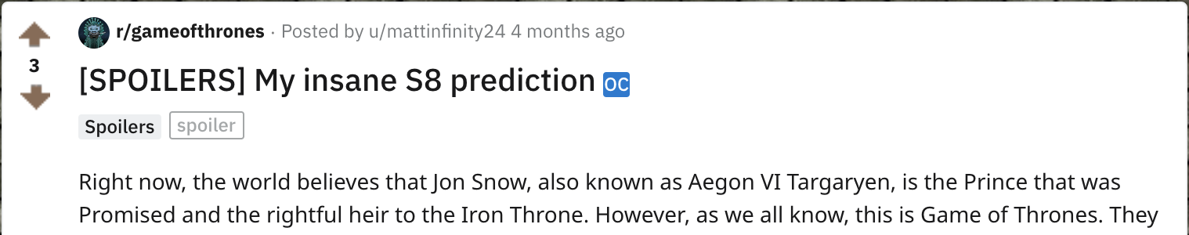
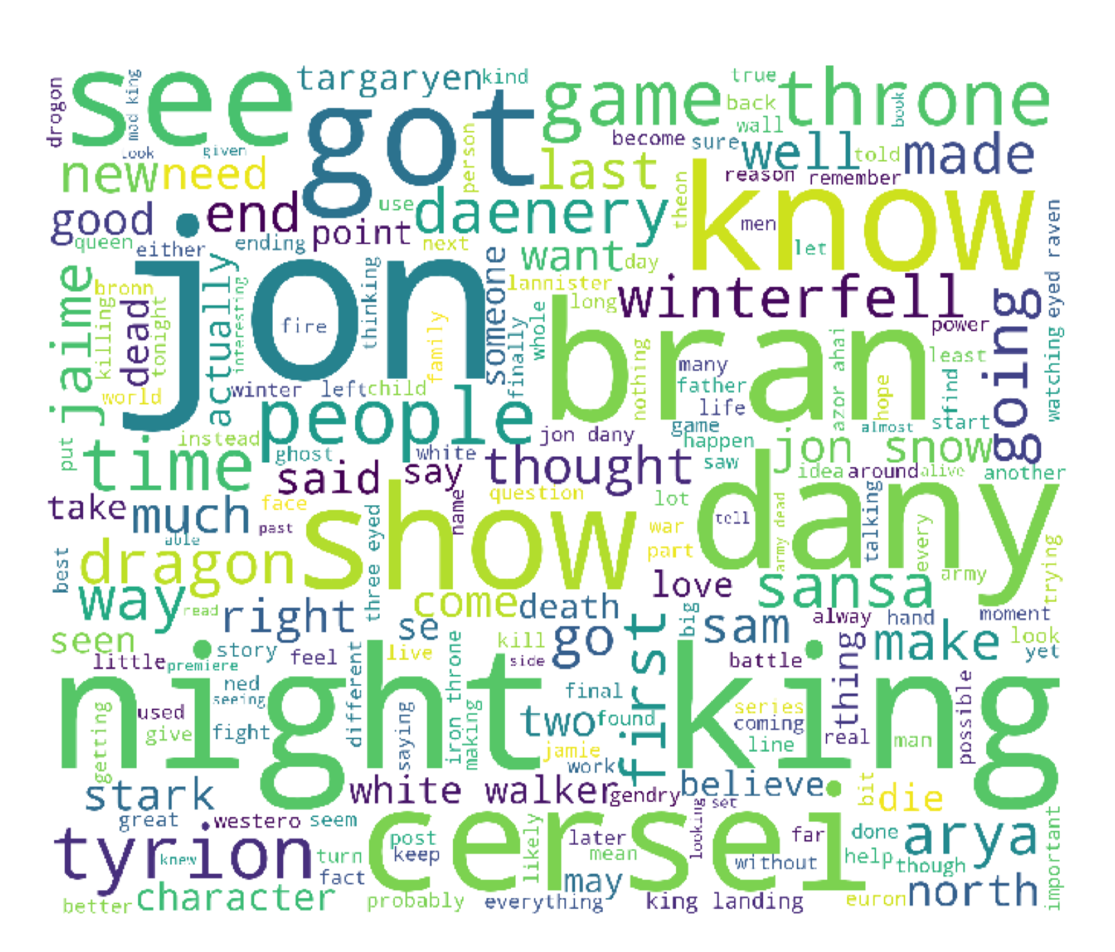
Before The Show Winterfell The Knight of the Seven Kingdoms
Defined by curiosity and speculation about the upcoming battle with Night King, the fate of Winterfell, and the impact of the looming battle on the broader story
Queens - Dany vs Cersei and the ultimate winner in this game of thrones
Dany's relationship to the North
Starks family lineage and relationship to Jon
Notes:
Natasha - The introductory period is dominated by speculation and theories concerning the upcoming battle for the future of Westeros, the night king’s invasion, and Jon and Dany’s response to the threat.
Cersei and her future are also discussed as the fans wonder how the two queens will clash with each other.
The overall sentiment is positive and anticipatory with theories flying around the fate of our favorite characters and posts such as
this one are numerous on all the channels.
Wild theories abound.

Slide 12
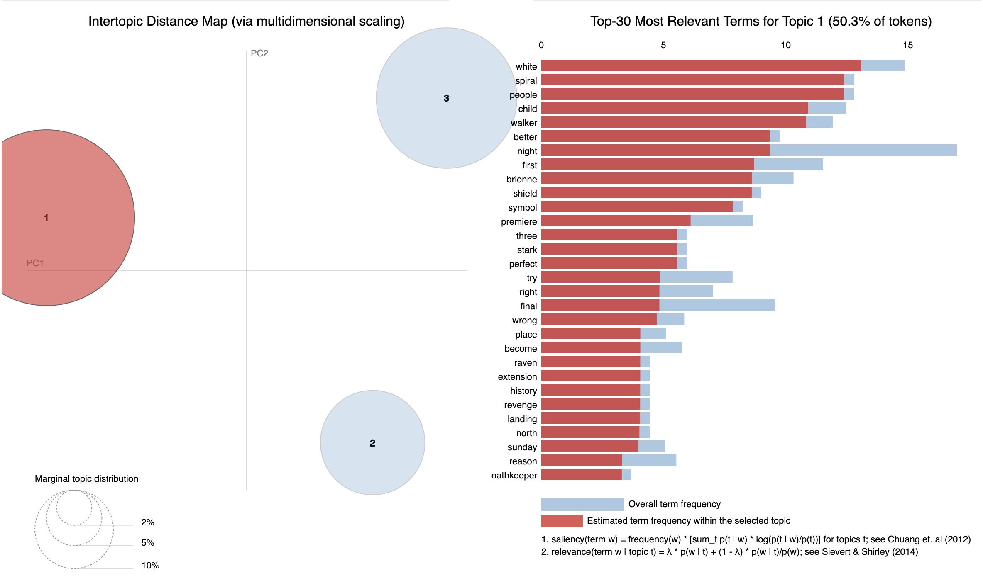
Notes:
Natasha - In examining the main topics of this period, one curious discovery is the topic covering the white walkers and their origin and symbology, going so far as to mention the spiral symbol of the night king and how they are made through the sacrifice of Kraster’s children.
Other topics cover the general theories about what’s going to happen during the season and speculation about the current intentions and condition of main show characters.

Slide 13
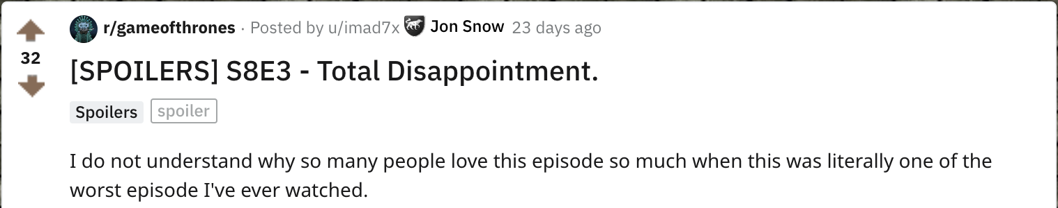
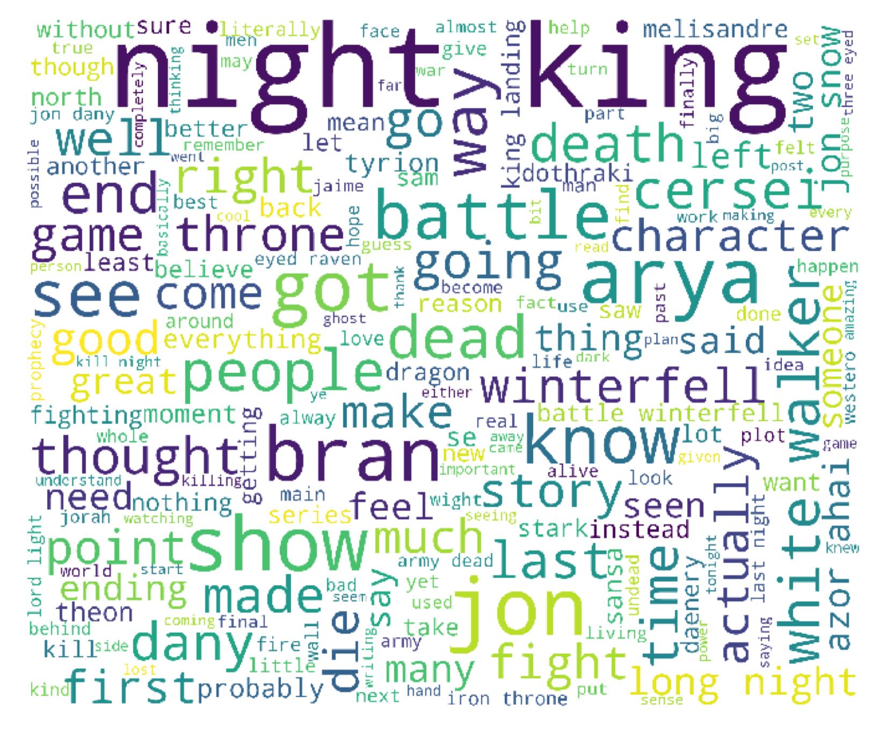
The Long Night the Last of the Starks
The Night King’s death (and its broader significance) dominated conversation following The Long Night
Conversation moved to the looming battle for King’s Landing and Dany’s mindset after The Last of the Starks
Notes:
Drake
Lannisters - Discussion of the battle's effect on the Lannisters, notably that they are all still alive; questions about whether Bronn will kill Jaime/Tyrion
Battle - Discussion of the battle itself, notably the Night King's spectacular death, white walkers, and Dothraki
Battle's Effect on GoT - focus on Sansa and the Starks/Winterfell

Slide 14
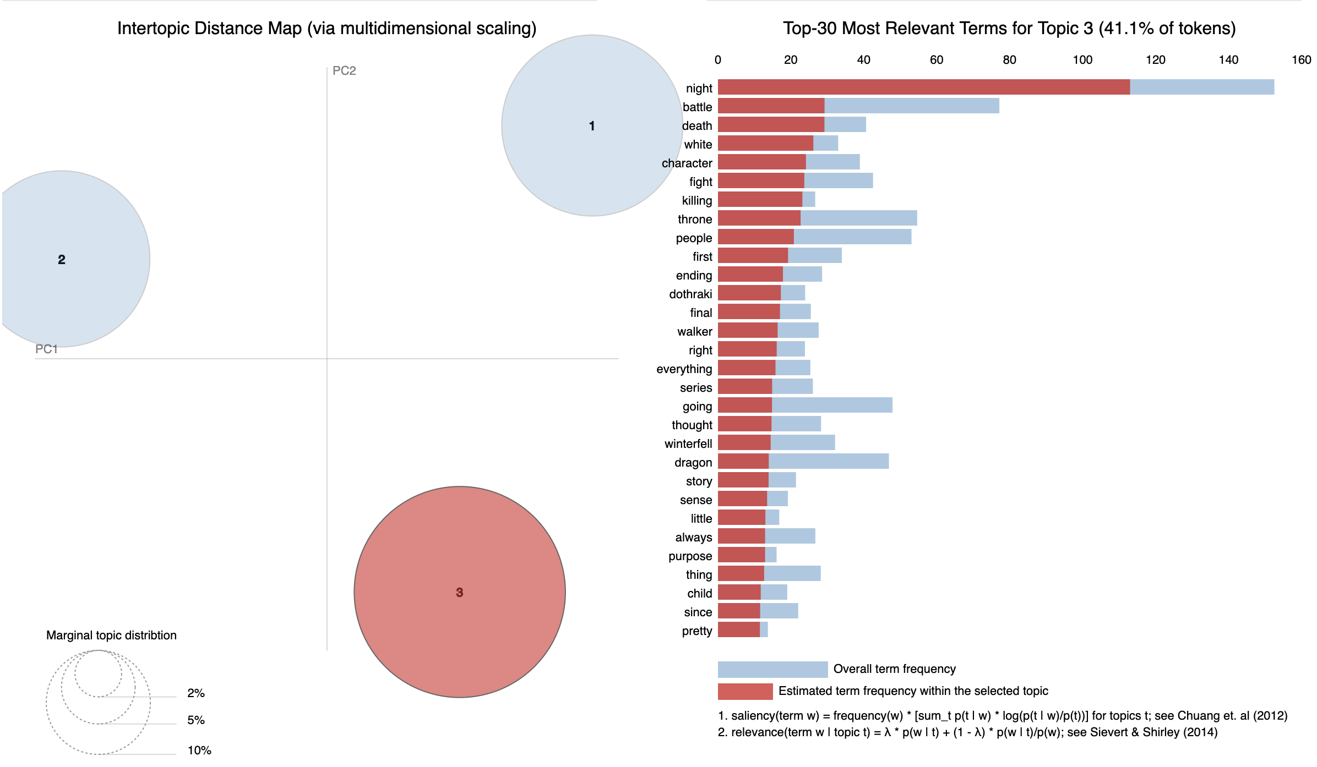
Notes:
Drake
- pyLDAvis shows the primary topic after episode 3 was around the battle against the Army of the Dead

Slide 15
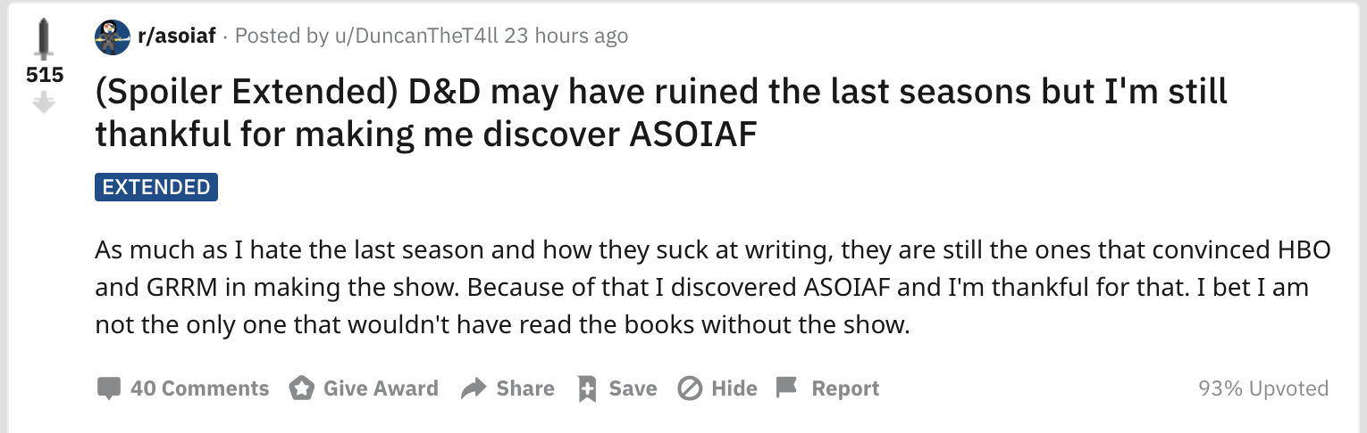
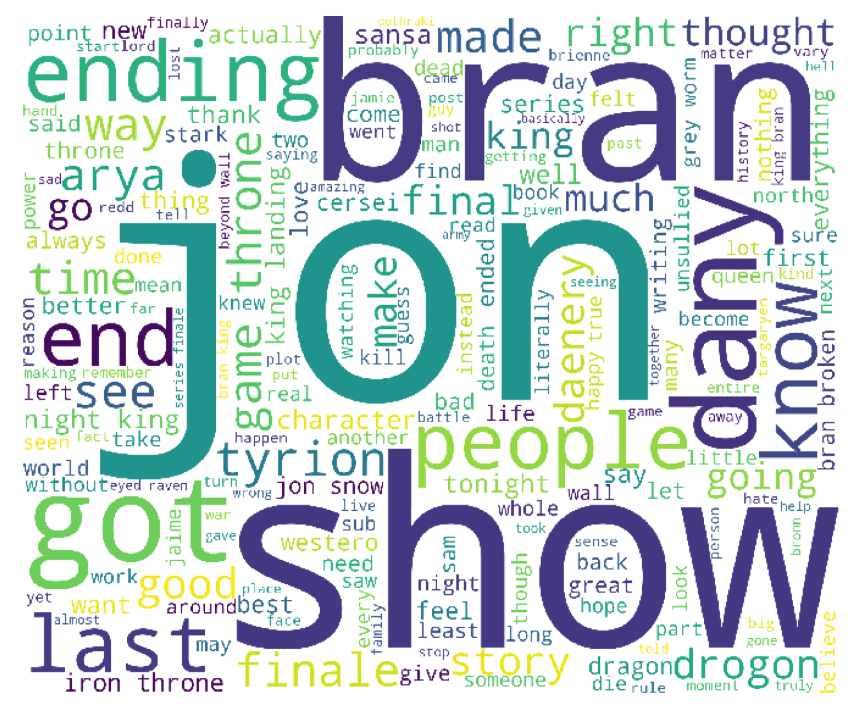
The Bells the Iron Throne
Jamie and Cersei’s death and the fate of King’s Landing emerges as a strong topic
Lift in sentiment driven by overall appreciation for show, not episode-specific like others
Notes:
Drake
Jamie & Cersei’s death and the fate of KL emerge as a topic after The Bells
For final episode, positive sentiment is driven by reflections on the show as a whole, not the specifics of the plot or episode like in previous episodes

Slide 16
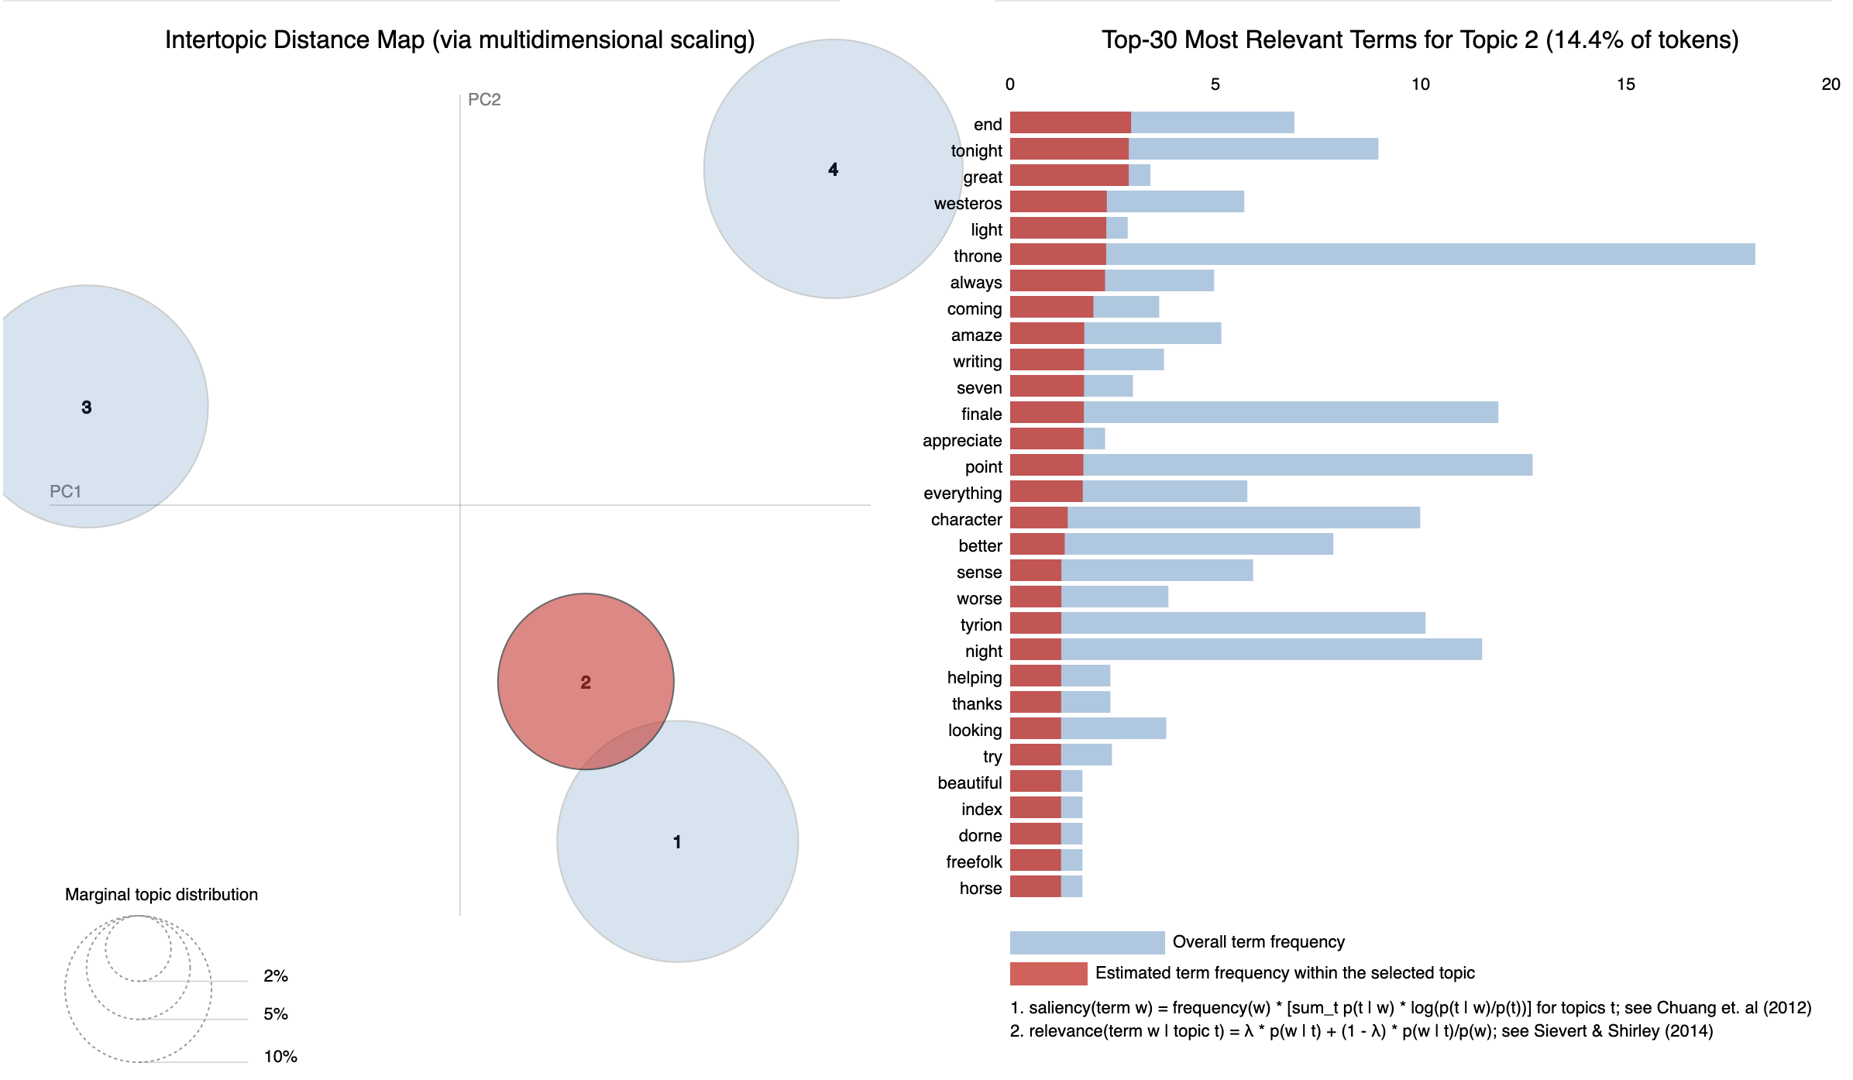
Notes:
Drake
Can see topics like focused on “the end of an era” driving positive sentiment

Slide 17
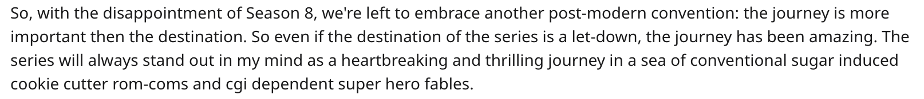
Final Thoughts
Emotional and sarcasm heavy social posts are difficult to interpret but they dominate modern online conversation
Game of Thrones final season bore a heavy burden of carrying many fans’ hopes and could not hope to please them all.
Harshest reactions have been heard the loudest but do not reflect the complete picture.
This show brought the genre of fantasy into the mainstream television and paved the way for other such productions.
Notes:
Natasha. Overall we have learned that the posts on social media are difficult to interpret as they are full of emotion and sarcasm.
Game of Thrones is a show that has carried a lot of hopes for many invested fans and any finale would have likely disappointed some of them.
As often happens, the harshest reactions were heard the loudest, but as we examined the data more thoroughly, there was appreciation for the show and the actors among the negative reactions, and people were thankful for the show bringing
their favorite novels to life.
Game of Thrones paved the way for the fantasy genre to enter mainstream media, and opened the doors for other high budget adaptations of popular fantasy novels. We have come to an end of an era and it was an amazing ride.

Slide 18
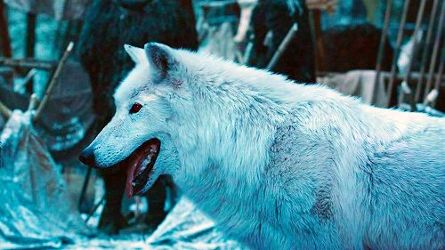
THANK you
Notes:
Natasha

Slide 19
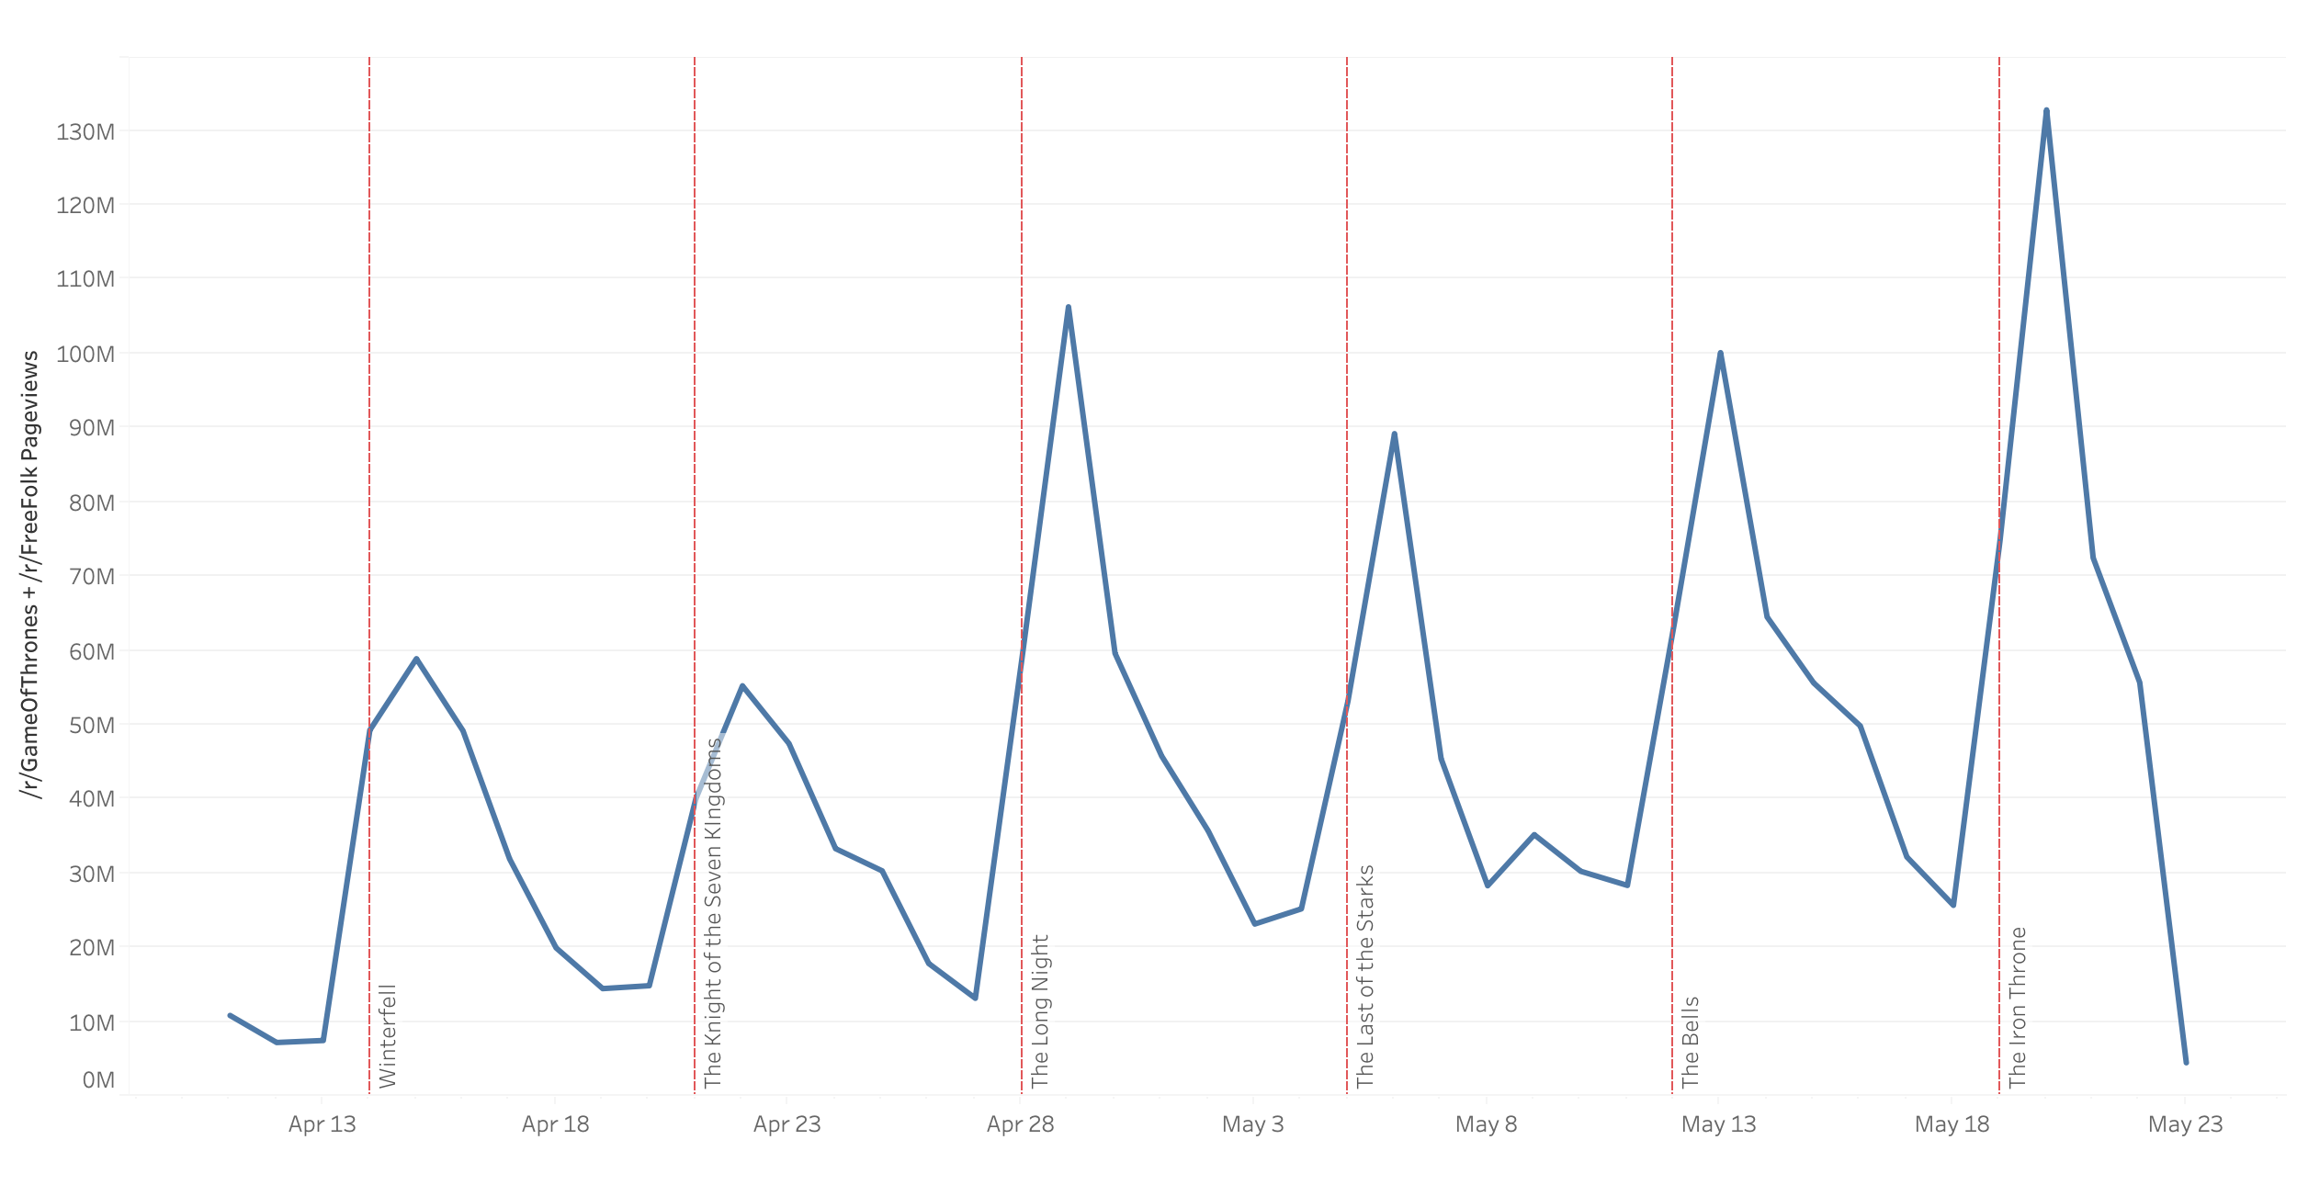
Reddit Pageviews

Slide 20
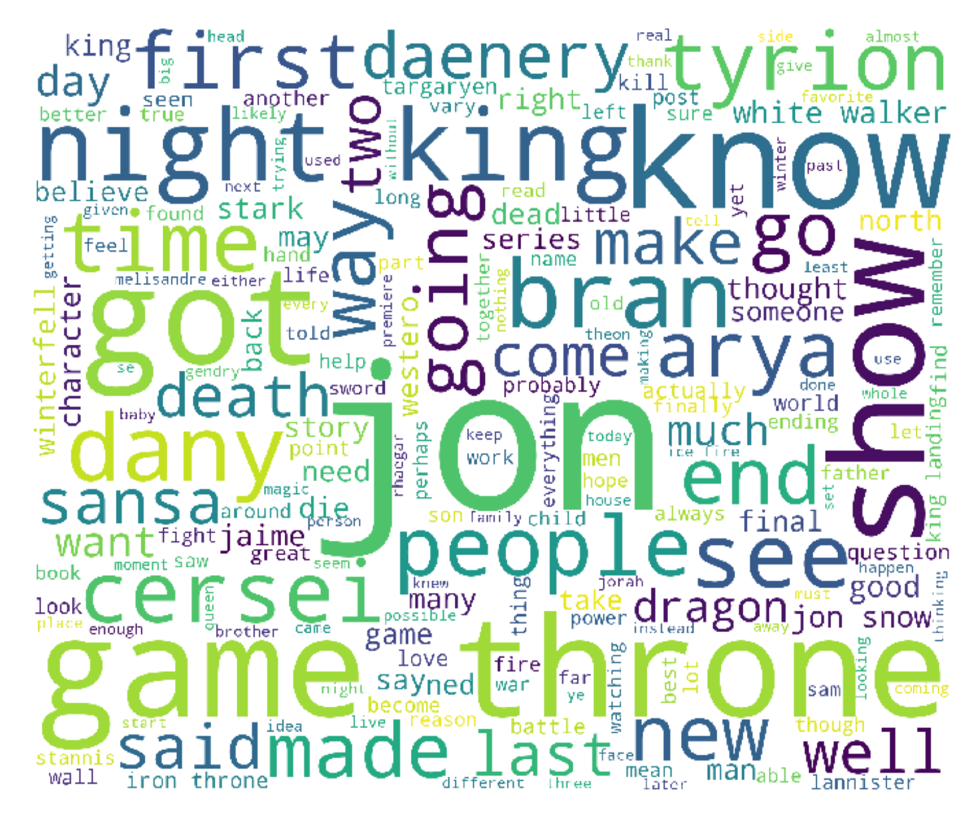
0 Before The Show
Defined by curiosity and speculation
Night King / Whitewalkers –questioning their broader intent and plans for Westeros
Queens - Dany vs Cersei and the ultimate winner in this game of thrones
Wild speculations about the fates of the characters
Mostly positive comments across the platforms
Notes:
The period before the season premiere is dominated by speculation and theories concerning the upcoming battle for the future of Westeros, the night king’s invasion, and Jon and Dany’s response to the threat. Cersei and her future are also discussed as the fans wonder how the two queens will clash with each other. The comments are overall neutral or positive, with only one dip into negativity from the the more book-loving a song of ice and fire.
Defined by curiosity and speculation*
Night King / Whitewalkers - curious about their broader intent, relationship to Westeros, etc.
Queens - Dany vs Cersei, how that impending conflict (game of thrones) will play out
Talking about speculating - super meta
Wild speculations about the fates of the characters
Mostly positive comments across the platforms
The discussion is dominated by Jon and the fate of the show as a whole.

Slide 21
Notes:
In examining the main topics of this period, one curious discovery is the topic covering the white walkers and their origin and symbology, going so far as to mention the spiral symbol of the night king and how they are made through the sacrifice of Kraster’s children. Other topics cover the general theories about what’s going to happen during the season and speculation about the current state of main show characters.

Slide 22
1 Winterfell
Mostly discussion of the plot, neutral
Lannisters - lots of discussion about Cersei's asking Bronn to kill Tyrion & Jamie
Dany's relationship to the North - Cool response from the Northmen to Dany's arrival
Starks – their family lineage and relationship to Jon
Notes:
The first episode aired with many familiar faces meeting each other for the first time or seeing each other for the first time since season one. The topics were largely anticipatory, and neutral focused on the upcoming plot and the relationships between various characters. Cersei asking Bronn to kill her brothers and Dany’s cool welcome in the North were covered among others, as well as the discussion of Jon’s lineage and how it might apply in the weeks to come.
Mostly discussion of the plot, neutral
Lannisters - lots of discussion about Cersei's asking Bronn to kill Tyrion & Jamie
Dany's relationship to the North - Cool response from the Northmen to Dany's arrival
Starks - Family lineage, related to Jon

Slide 23
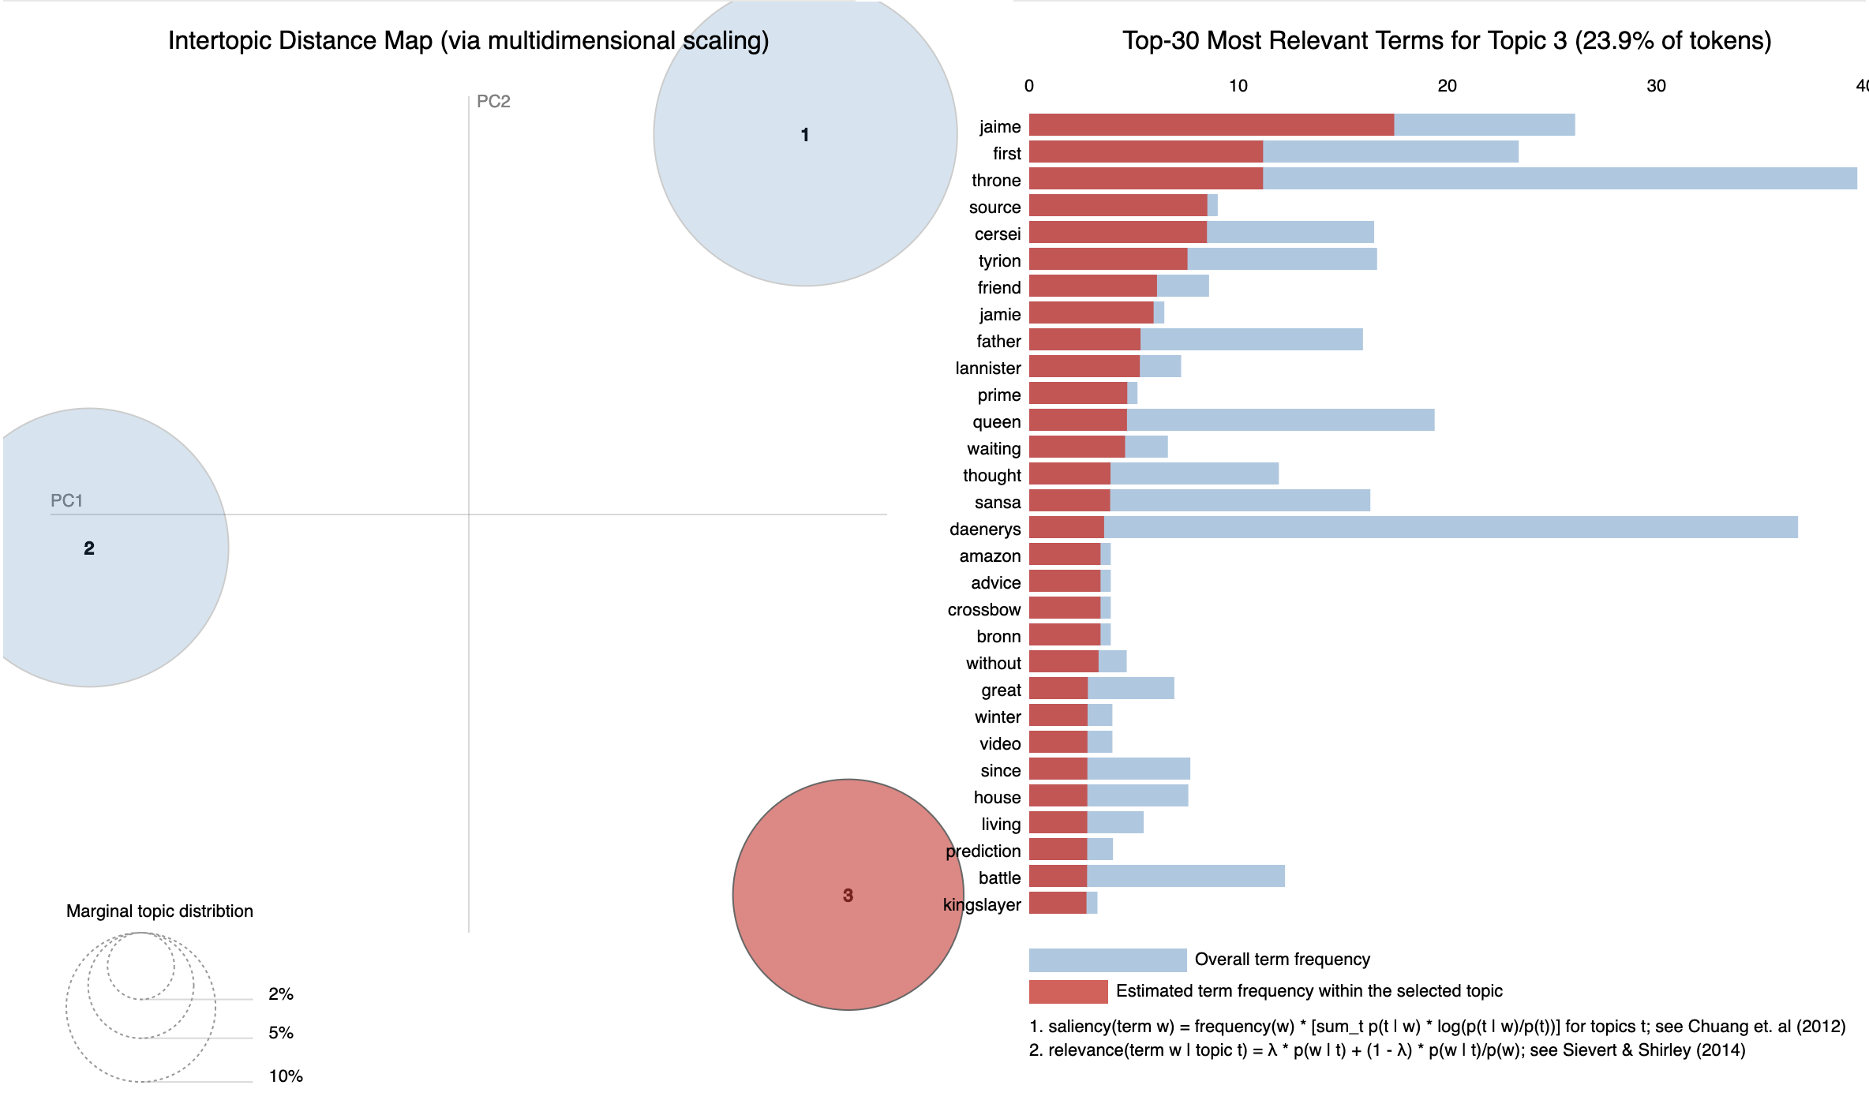
Notes:
We settled on three topics for this episode, the most interesting one focusing on Jamie, Cersei and Tyrion and how their relationship as the last members of their family, whereas the other two topics focus on Daenerys and the Stark family. Daenerys and Throne as the two most frequently mentioned terms in this episode with Jaime following.

Slide 24
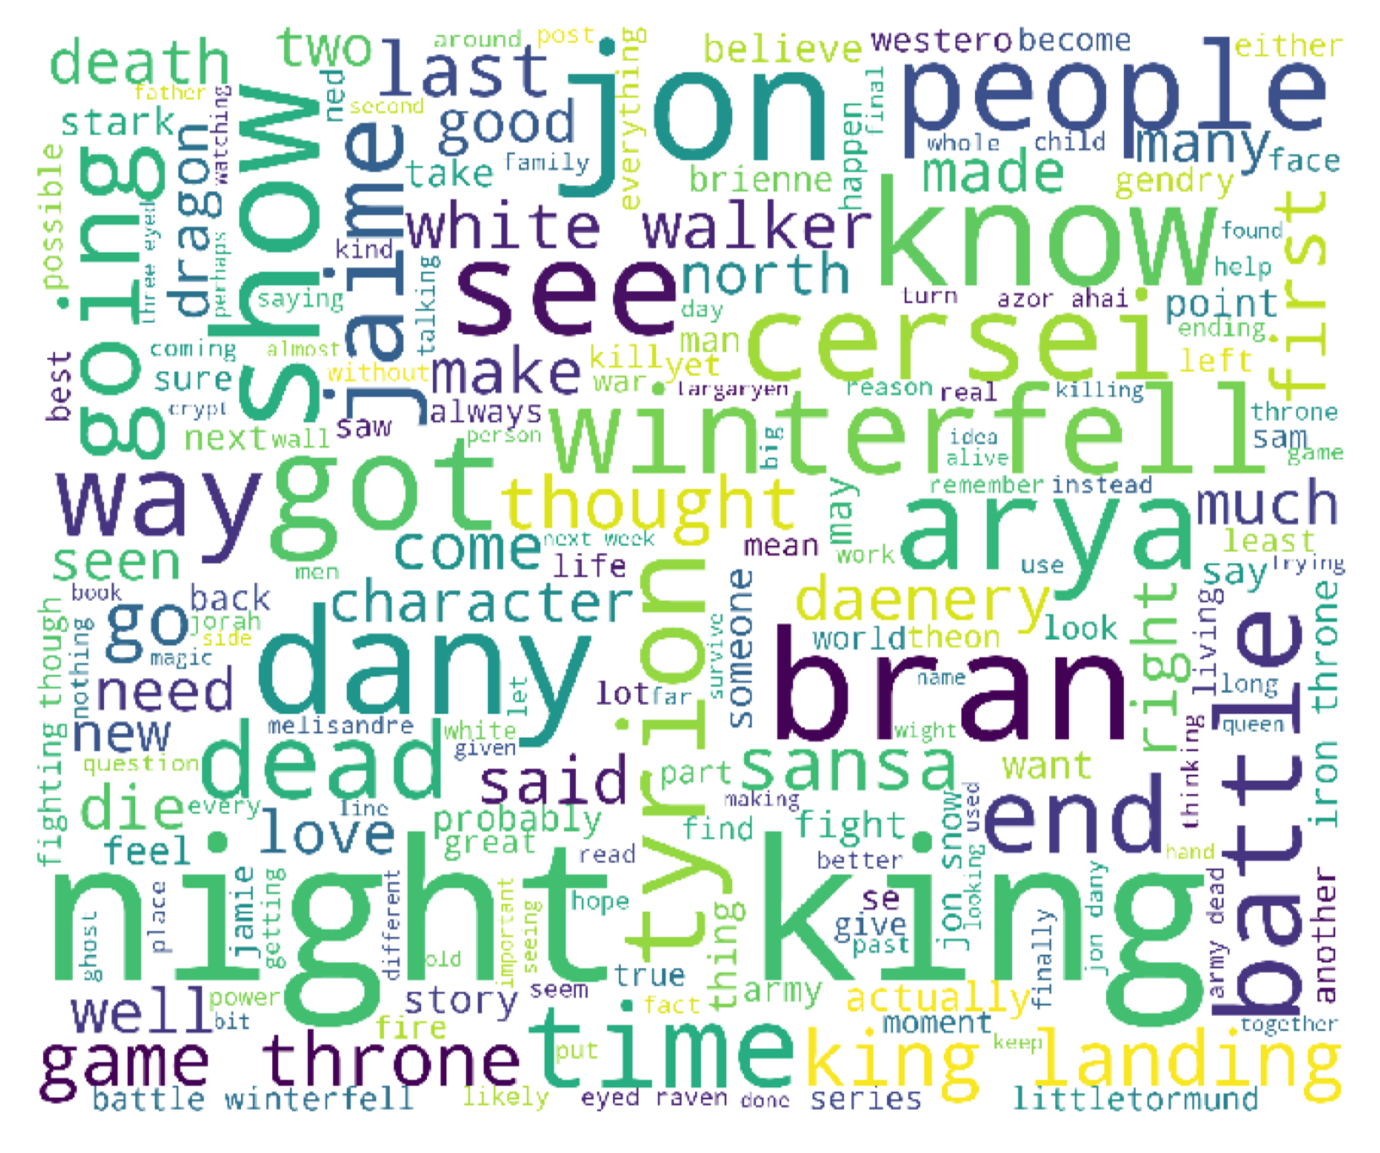
2 The Knight of the Seven Kingdoms
Overall neutral, Brienne is not a major contributor to either topic
Upcoming battle - discussion of the Night King, the fate of Winterfell, and the impact of the looming battle on the broader story
Characters - a review of characters from the episode, Gendry and Jamie are more popular terms than Brienne
Notes:
I was pleased that Brienne of Tarth was indeed discussed after this episode but not as widely as I think she deserved. The primary discussion swirled around the upcoming battle, and the Night King as well as how the outcome of the battle would affect the rest of the season and the characters who would survive. Gendry and Jamie are mentioned more often than Brienne, which is not surprising considering Gendry’s progress with Arya and Jamie’s trial by Sansa and Daenerys with an uneasy Jon between them.
Neutral, interestingly Brienne is not a major contributor to either topic
Upcoming battle - discussion of the Night King, the fate of Winterfell, and the impact of the looming battle on the broader story
Characters - Kind of a review of characters from the episode, surprisingly Gendry and Jamie are more popular terms than Brienne

Slide 25
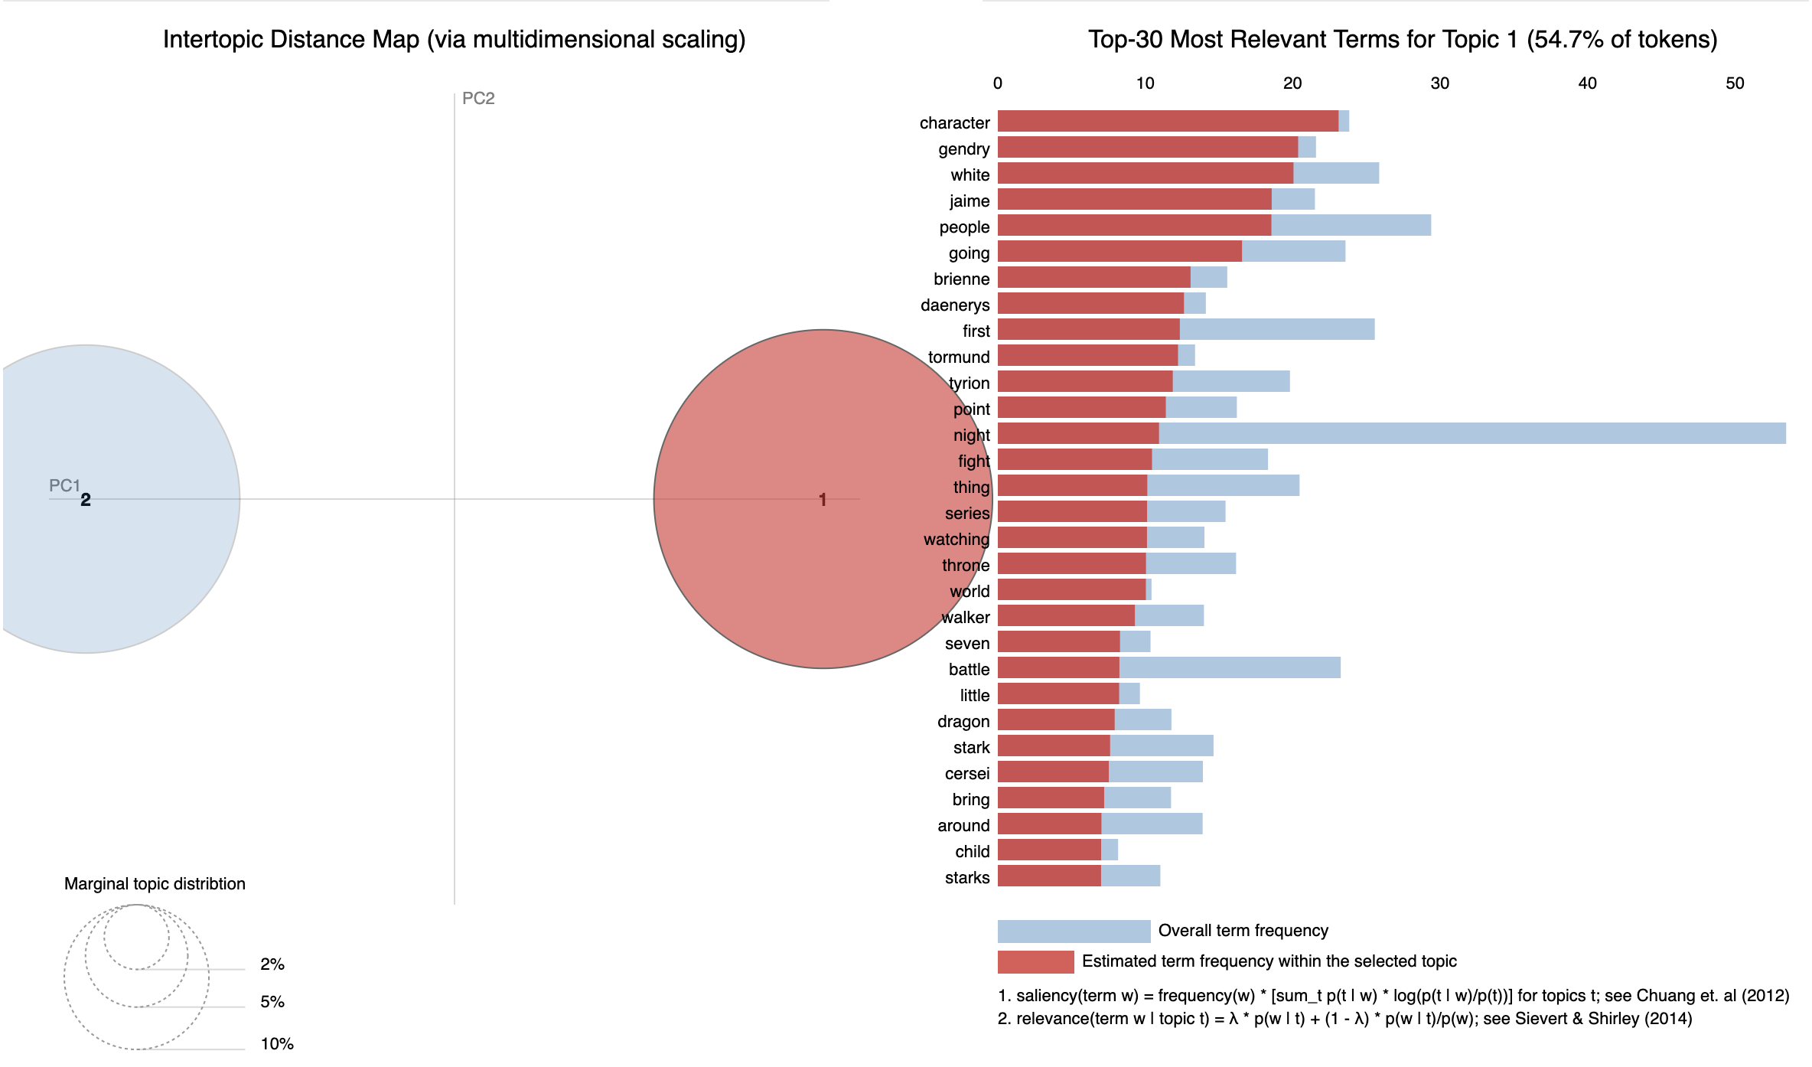

Slide 26
3 The Long Night
Lannisters - Discussion of the battle's effect on the Lannisters, notably that they are all still alive; questions about whether Bronn will kill Jaime/Tyrion
Battle - Discussion of the battle itself, notably the Night King, white walkers, and Dothraki
Battle's Effect on GoT - focus on Sansa and the Starks/Winterfell
The Night King’s spectacular death dominated the fans’ conversation following this episode.
Sentiments
Notes:
Lannisters - Discussion of the battle's effect on the Lannisters, notably that they are all still alive; questions about whether Bronn will kill Jaime/Tyrion
Battle - Discussion of the battle itself, notably the Night King, white walkers, and Dothraki
Battle's Effect on GoT - focus on Sansa and the Starks/Winterfell
The Night King’s spectacular death dominated the fans’ conversation following this episode.
Sentiments

Slide 28
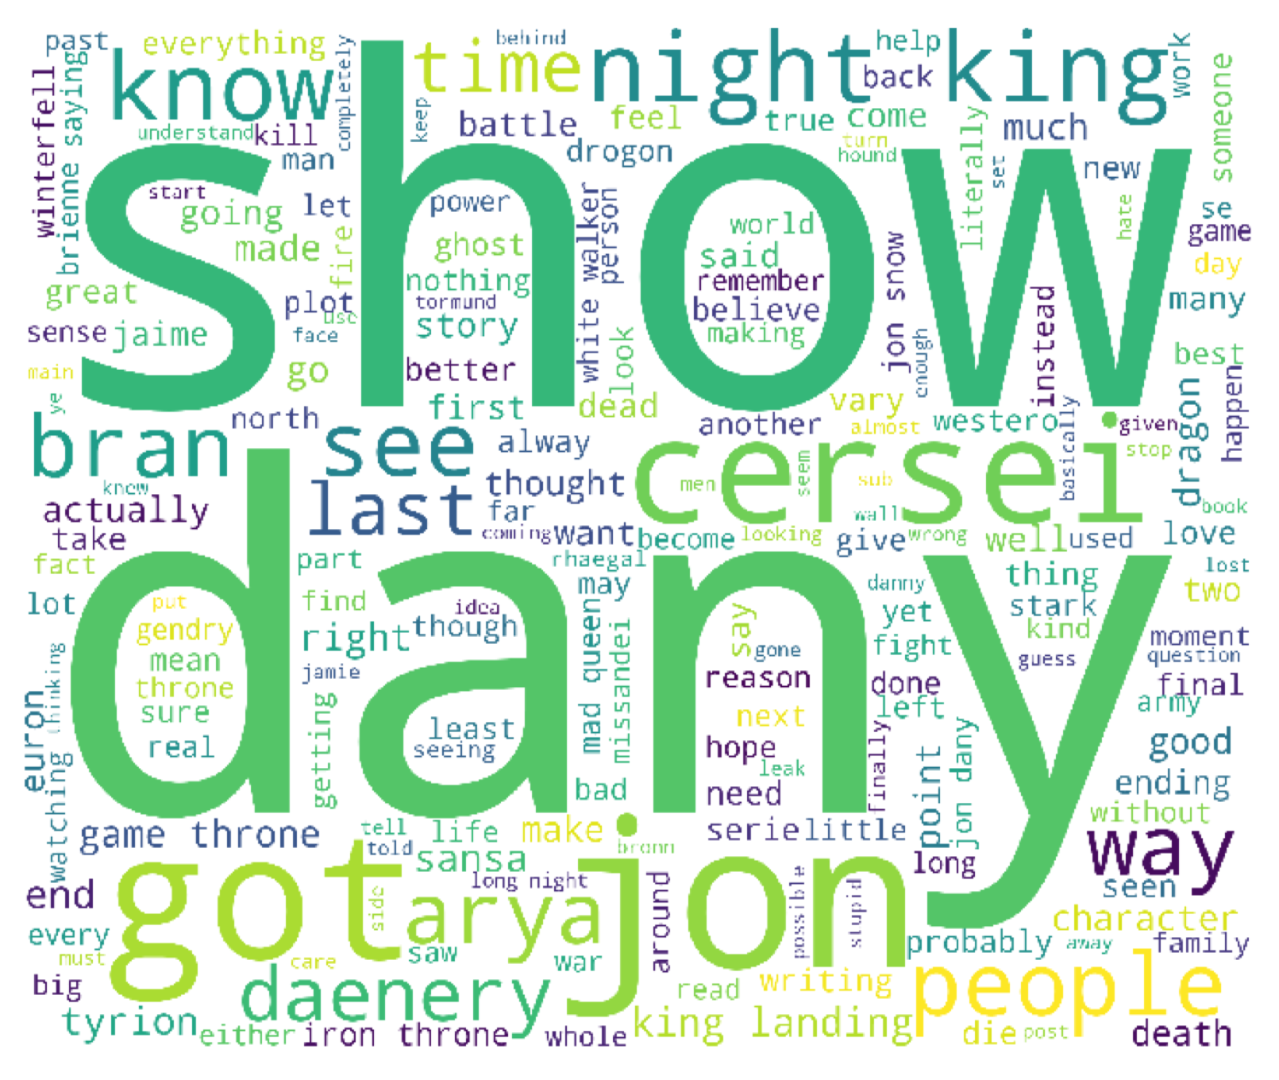
4 The Last of the Starks
The anticipation of the battle and Dany’s upcoming decisions and behavior are on the forefront of fans’ minds.
Speculations about the show’s end are creeping into the discussions for the first time.
The week following this episode saw some of the most negative sentiment expressions of the season.
Notes:
The anticipation of the battle and Dany’s upcoming decisions and behavior are on the forefront of fans’ minds.
Speculations about the show’s end are creeping into the discussions for the first time.
The week following this episode saw some of the most negative sentiment expressions of the season.

Slide 29
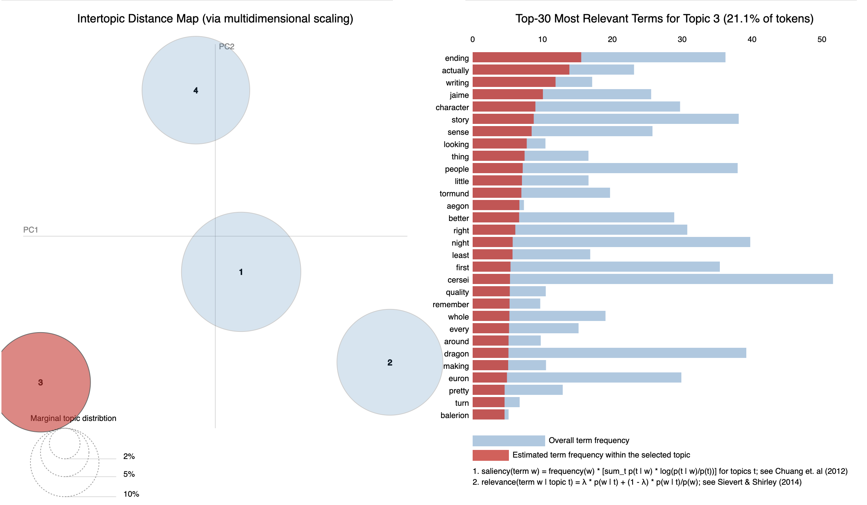

Slide 30
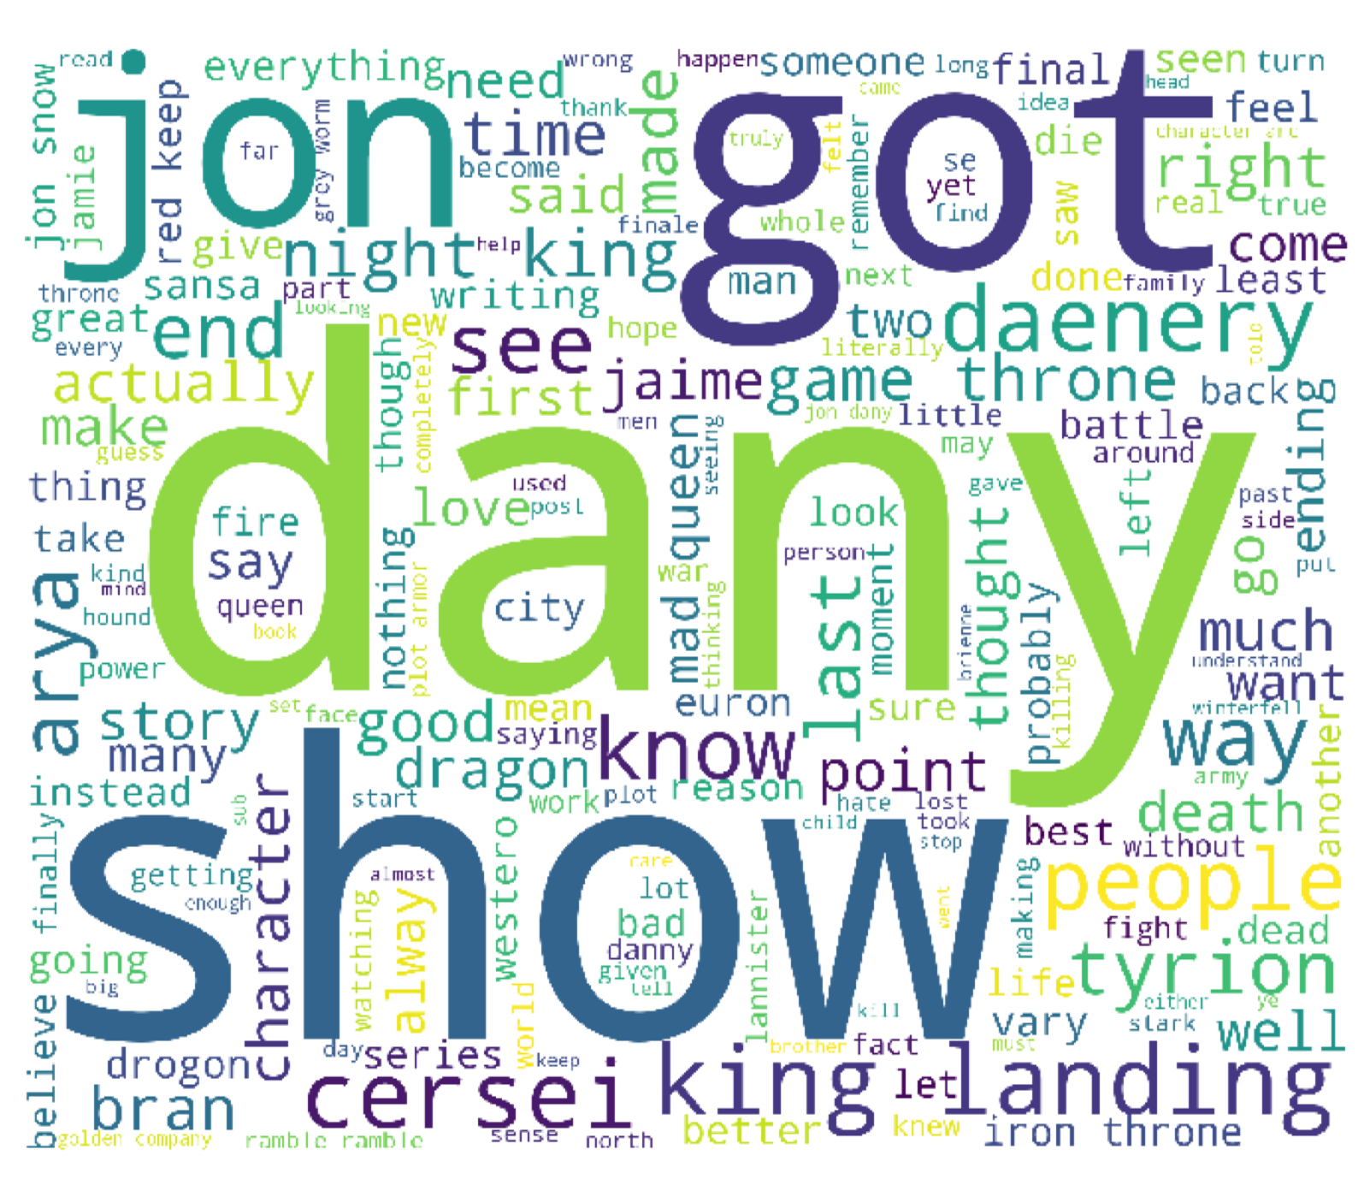
5 The Bells
Fewer negative reactions than expected
Jamie and Cersei’s death and the fate of King’s Landing emerges as a strong topic
The question of who will end up on the Iron Throne is raised and remains on everyone’s minds
Topics
Notes:
Fewer negative reactions than expected
Jamie and Cersei’s death and the fate of King’s Landing emerges as a strong topic
The question of who will end up on the Iron Throne is raised and remains on everyone’s minds

Slide 31
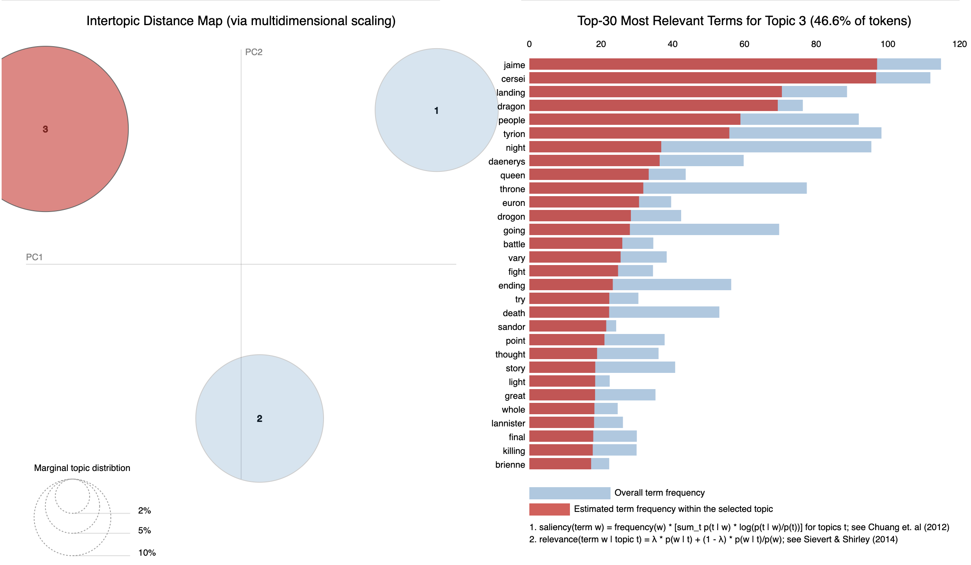

Slide 32
6 The Iron Throne
All topics have the flavor of finality, and the discussion about the fate of Westeros and main characters’ storylines dominates the discussion.
Sentiment has a surprising upwards trend.
Emotional response to the show as a whole can be seen through the prevalence of such words as ‘cry’ and ‘ending’, ‘great’ and ‘happy’.
Topics
Notes:
All topics have the flavor of finality, and the discussion about the fate of Westeros and main characters’ storylines dominates the discussion.
Sentiment has a surprising upwards trend.
Emotional response to the show as a whole can be seen through the prevalence of such words as ‘cry’ and ‘ending’, ‘great’ and ‘happy’.

